Slide 1

Chapter 1
Introduction
Copyright © The McGraw-Hill Companies, Inc. Permission required for reproduction or display.

Slide 2
1-1 DATA COMMUNICATIONS
The term telecommunication means communication at a distance. The word data refers to information presented in whatever form is agreed upon by the parties creating and using the data. Data communications are the exchange of data between two devices via some form of transmission medium such as a wire cable.
Topics discussed in this section:
Components of a data communications system
Data Flow

Slide 3
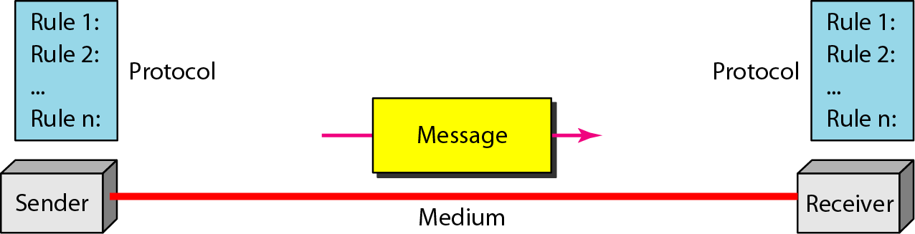
Figure 1.1 Components of a data communication system

Slide 4
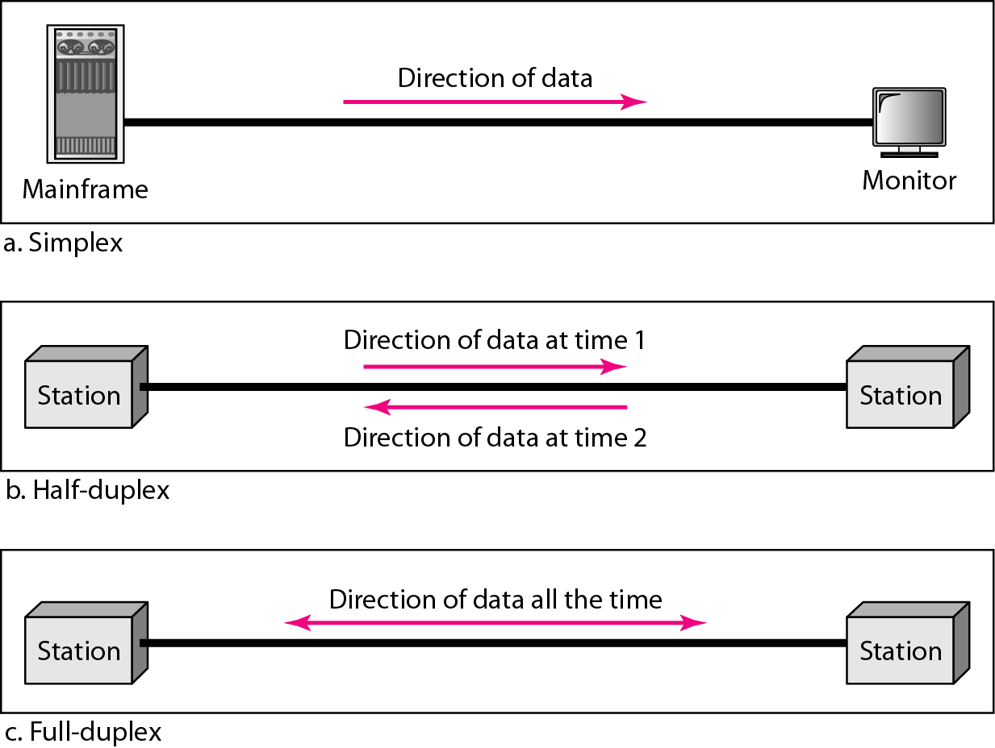
Figure 1.2 Data flow (simplex, half-duplex, and full-duplex)

Slide 5
1-2 NETWORKS
A network is a set of devices (often referred to as nodes) connected by communication links. A node can be a computer, printer, or any other device capable of sending and/or receiving data generated by other nodes on the network. A link can be a cable, air, optical fiber, or any medium which can transport a signal carrying information.
Topics discussed in this section:
Network Criteria
Physical Structures
Categories of Networks

Slide 6
Network Criteria
Performance
Depends on Network Elements
Measured in terms of Delay and Throughput
Reliability
Failure rate of network components
Measured in terms of availability/robustness
Security
Data protection against corruption/loss of data due to:
Errors
Malicious users

Slide 7
Physical Structures
Type of Connection
Point to Point - single transmitter and receiver
Multipoint - multiple recipients of single transmission
Physical Topology
Connection of devices
Type of transmission - unicast, mulitcast, broadcast

Slide 8
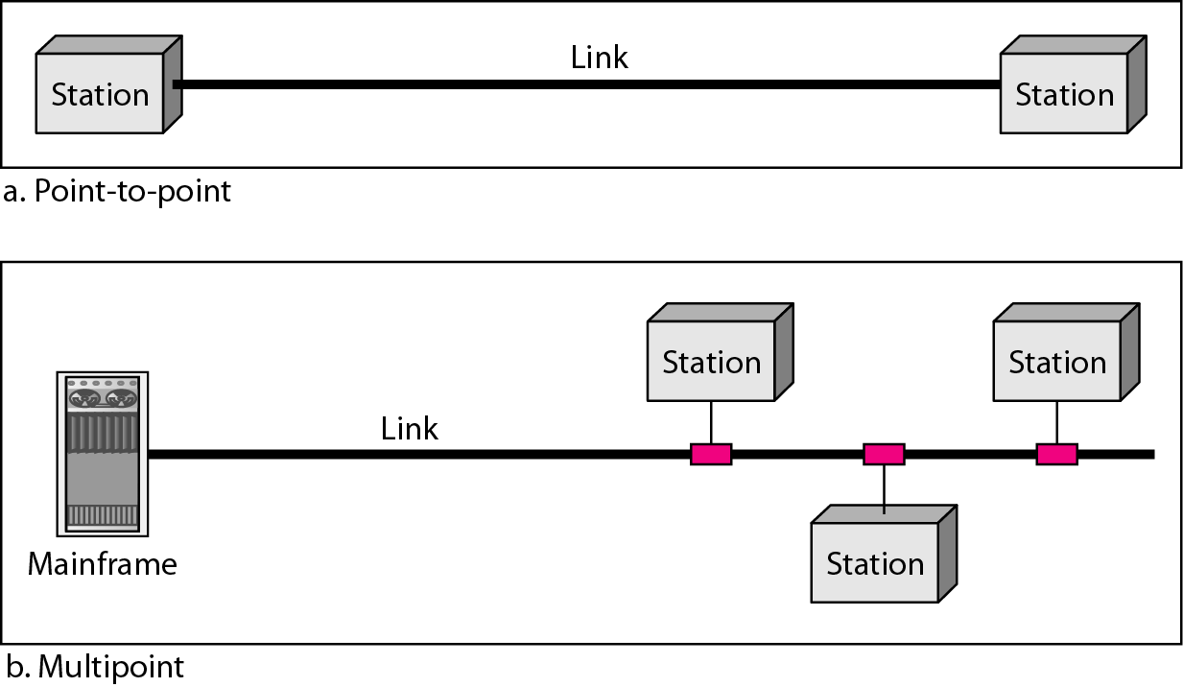
Figure 1.3 Types of connections: point-to-point and multipoint

Slide 9
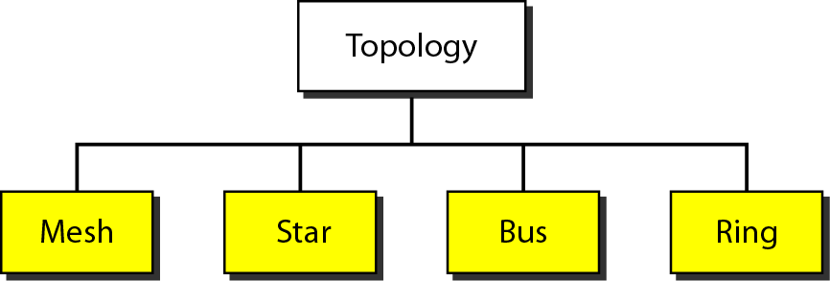
Figure 1.4 Categories of topology

Slide 10
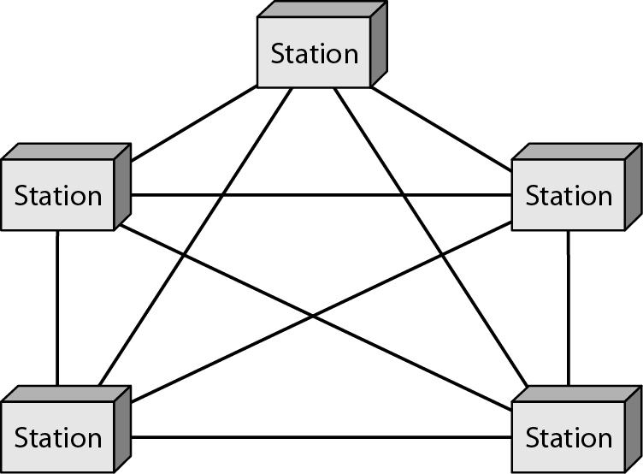
Figure 1.5 A fully connected mesh topology (five devices)

Slide 11
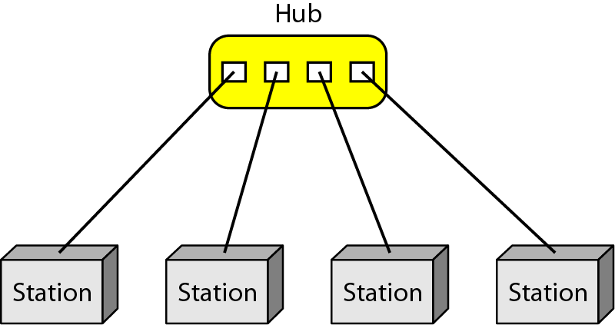
Figure 1.6 A star topology connecting four stations

Slide 12
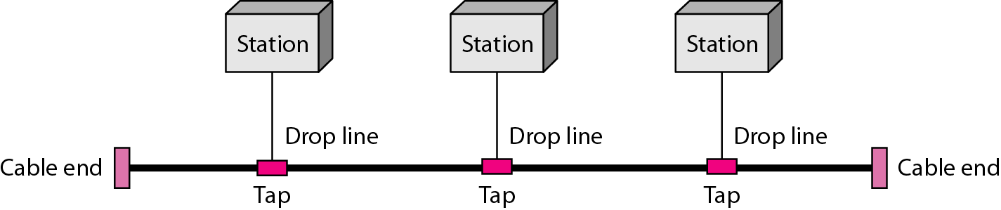
Figure 1.7 A bus topology connecting three stations

Slide 13
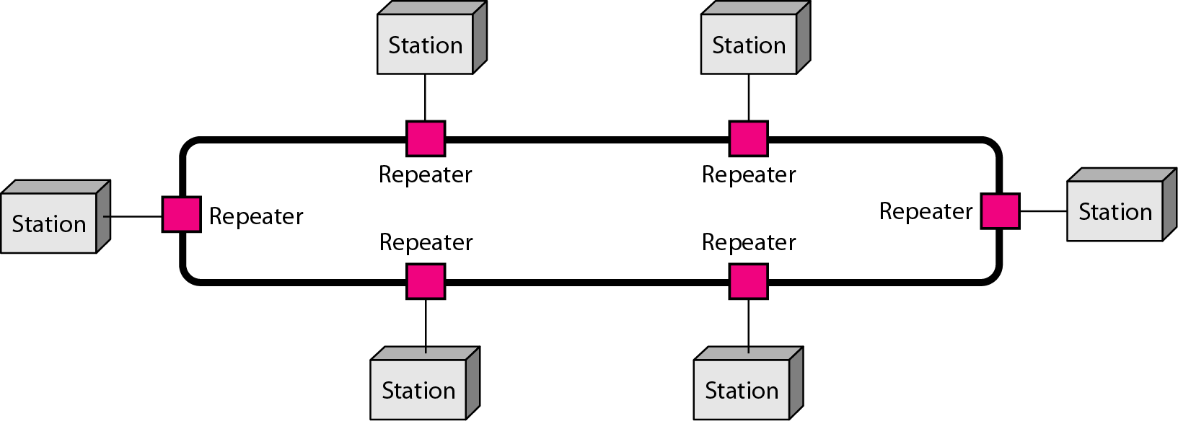
Figure 1.8 A ring topology connecting six stations

Slide 14
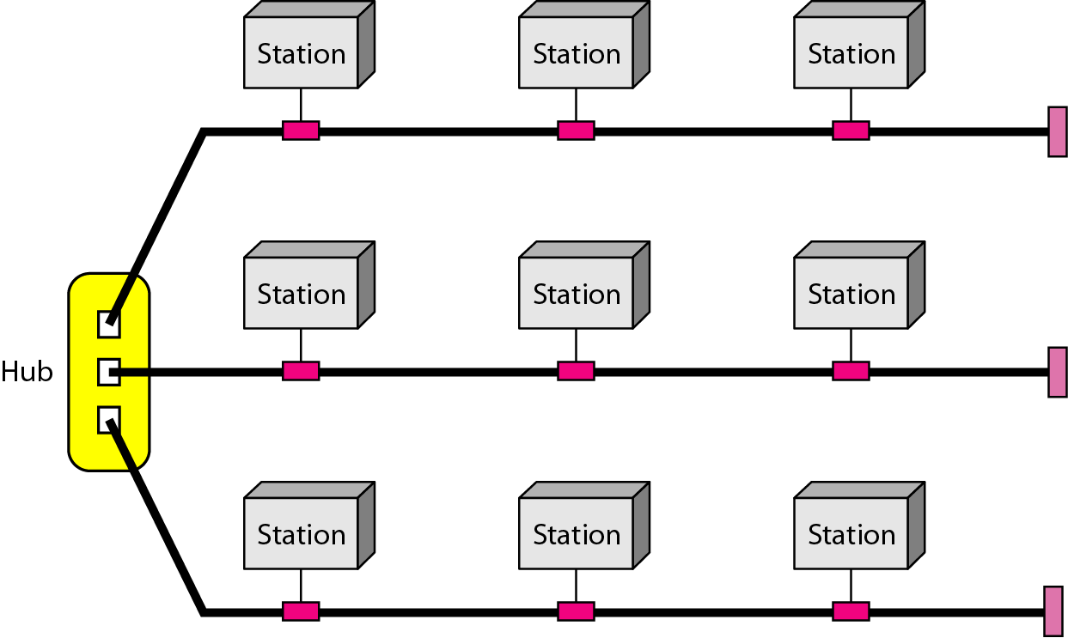
Figure 1.9 A hybrid topology: a star backbone with three bus networks

Slide 15
Categories of Networks
Local Area Networks (LANs)
Short distances
Designed to provide local interconnectivity
Wide Area Networks (WANs)
Long distances
Provide connectivity over large areas
Metropolitan Area Networks (MANs)
Provide connectivity over areas such as a city, a campus

Slide 16
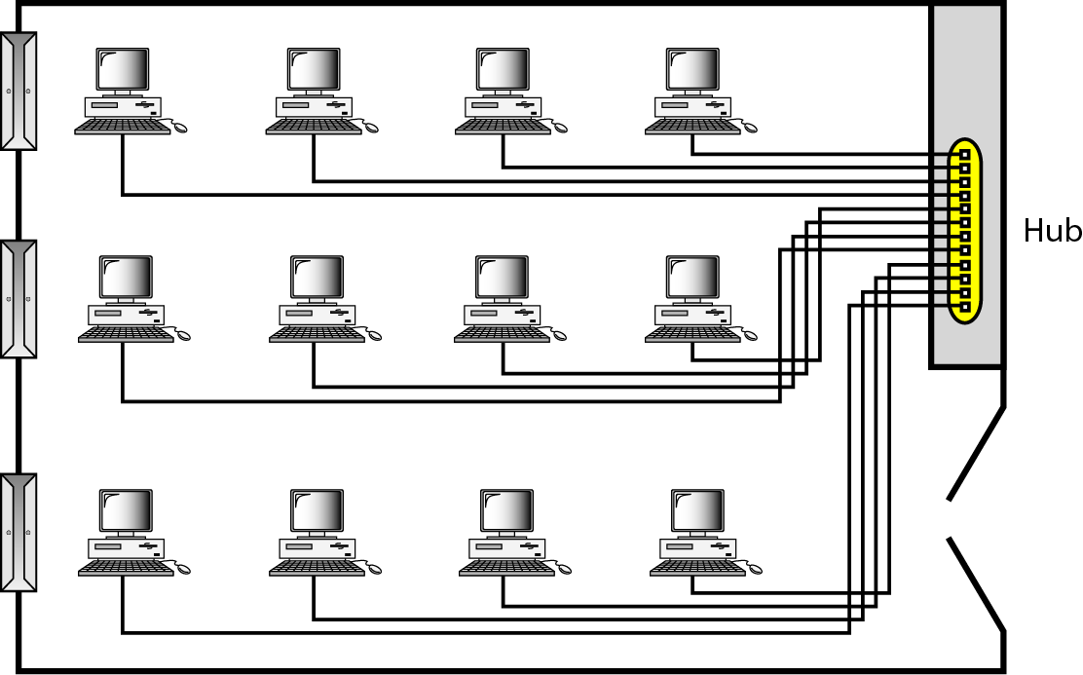
Figure 1.10 An isolated LAN connecting 12 computers to a hub in a closet

Slide 17
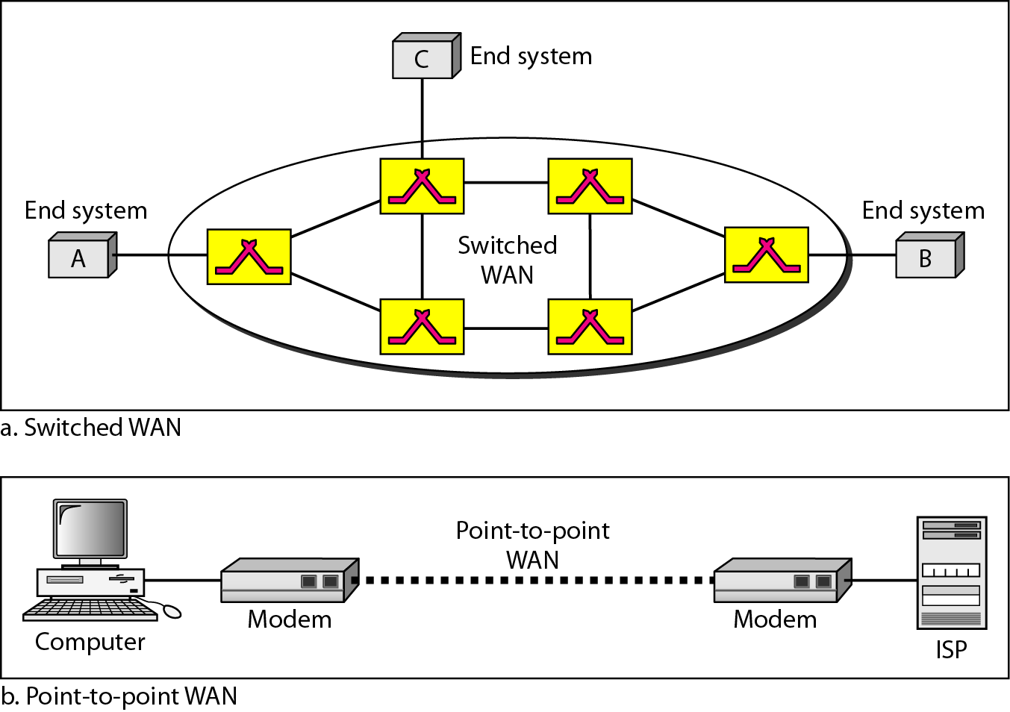
Figure 1.11 WANs: a switched WAN and a point-to-point WAN

Slide 18
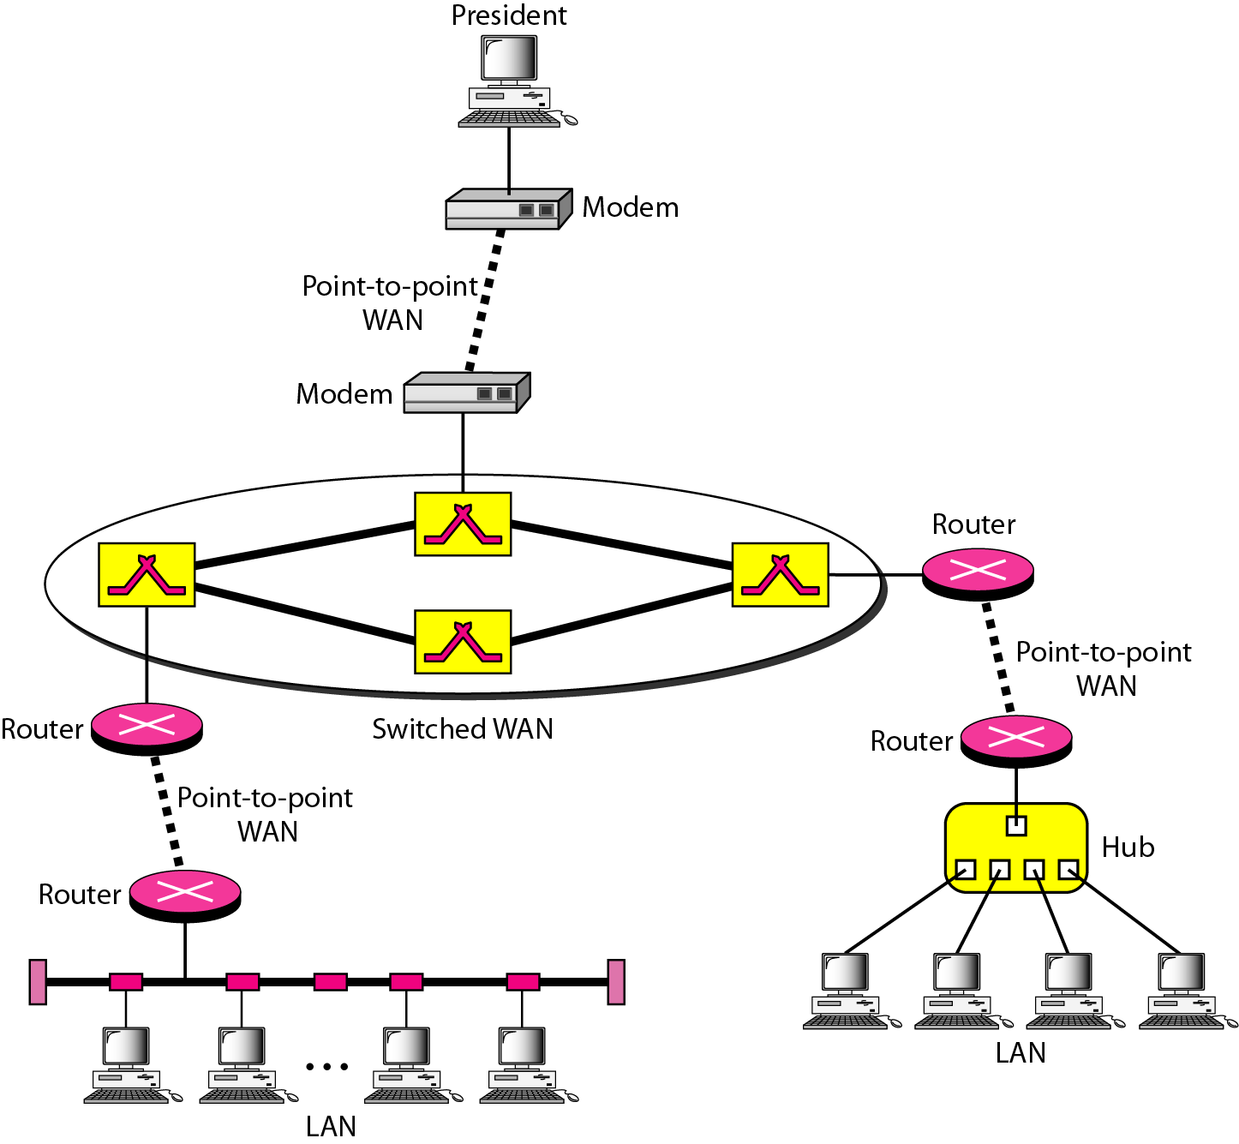
Figure 1.12 A heterogeneous network made of four WANs and two LANs

Slide 19
1-3 THE INTERNET
The Internet has revolutionized many aspects of our daily lives. It has affected the way we do business as well as the way we spend our leisure time. The Internet is a communication system that has brought a wealth of information to our fingertips and organized it for our use.
Topics discussed in this section:
Organization of the Internet
Internet Service Providers (ISPs)

Slide 20
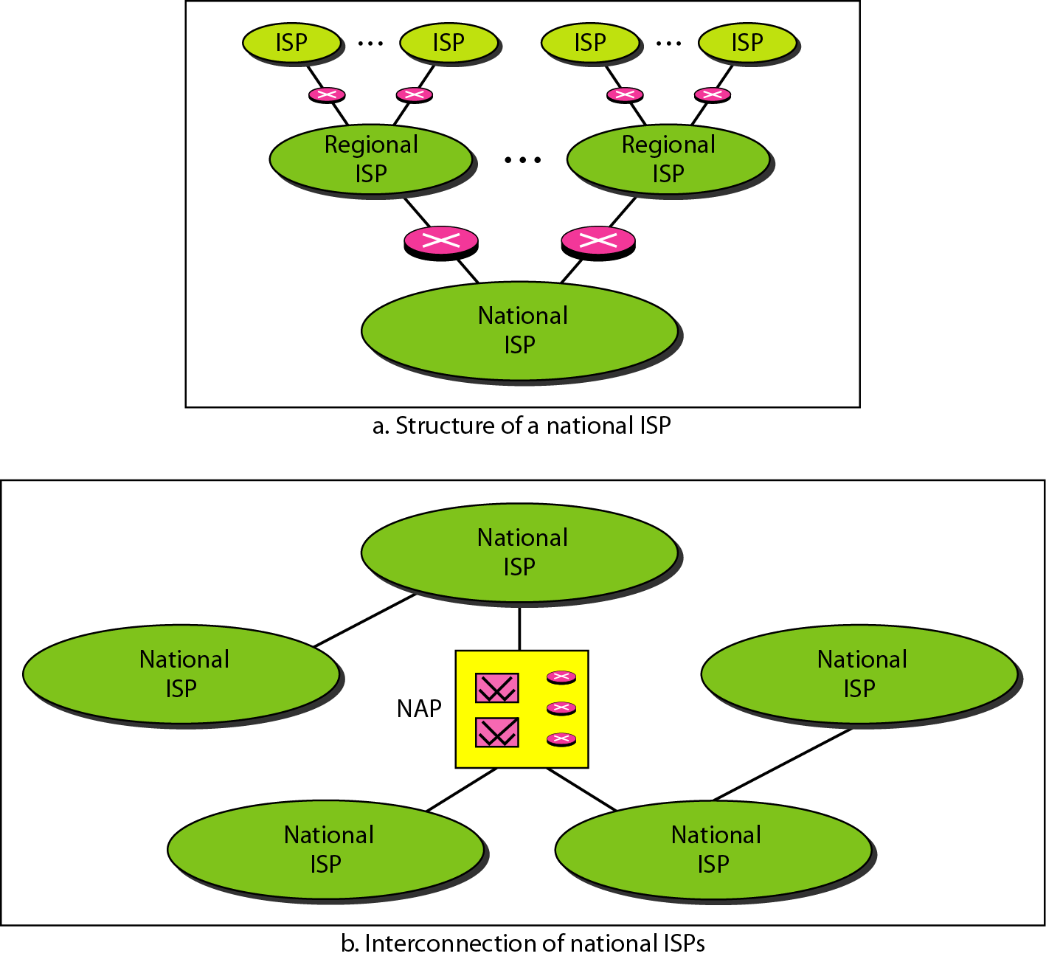
Figure 1.13 Hierarchical organization of the Internet

Slide 21
1-4 PROTOCOLS
A protocol is synonymous with rule. It consists of a set of rules that govern data communications. It determines what is communicated, how it is communicated and when it is communicated. The key elements of a protocol are syntax, semantics and timing
Topics discussed in this section:
Syntax
Semantics
Timing

Slide 22
Elements of a Protocol
Syntax
Structure or format of the data
Indicates how to read the bits - field delineation
Semantics
Interprets the meaning of the bits
Knows which fields define what action
Timing
When data should be sent and what
Speed at which data should be sent or speed at which it is being received.

